Slide 1
Supply Chain Management System
Name | mail
Md. Rakib Hasan | rakib.live95@gmail.com

Slide 2
INTRODUCTION:
This Application a supply chain management System .
Admin Adding the new Agent-User Easily.
Agent can add a new farmer .
Agent Collect product and Shipment easily
Farmers can easily Sell their products with fair price .
Farmer get the sell information via sms.
Admin Easily sell to Customer.
The buyer will undoubtedly get the hygienic and quality Product
Supply Chain Management System

Slide 3
Motivation:
Product prices can be controlled using a supply chain management system.
Since the product is not bought and sold in contact with dishonest people
People will not get adulterated products.
Buyers and Sellers will always benefit.
Supply Chain Management System

Slide 4
Objectives:
Buyer get the different type product and hygienic product.
Agent get the shipment status
Admin Authorize Shipment Request.
Admin can Receive Shipment Product.
Through this system we can know profit and loss information, purchase, sales and all product information
Supply Chain Management System

Slide 5
SUPPORTING TOOLS:
Microsoft Visual Studio 2013
MSSQL Server 2008
Supply Chain Management System

Slide 6
Features: (Admin Panel)
Inventory Setup
Product Setup
UOM Setup
Category Setup
Sub Category Setup
Administrative
New User Create
New Group Setup
Inventory Management
Purchased Authorized
Product Received
Product Stock
Product Distribution
Report
Purchase Information
Purchase Status
Product Received Information
Sales Information
Stock Information
Profit & Loss
PIMS Setup
New Client
Supply Chain Management System

Slide 7
Features: (Agent Panel)
Farmer Info
Product Collection
Shipment Request
Supply Chain Management System

Slide 8
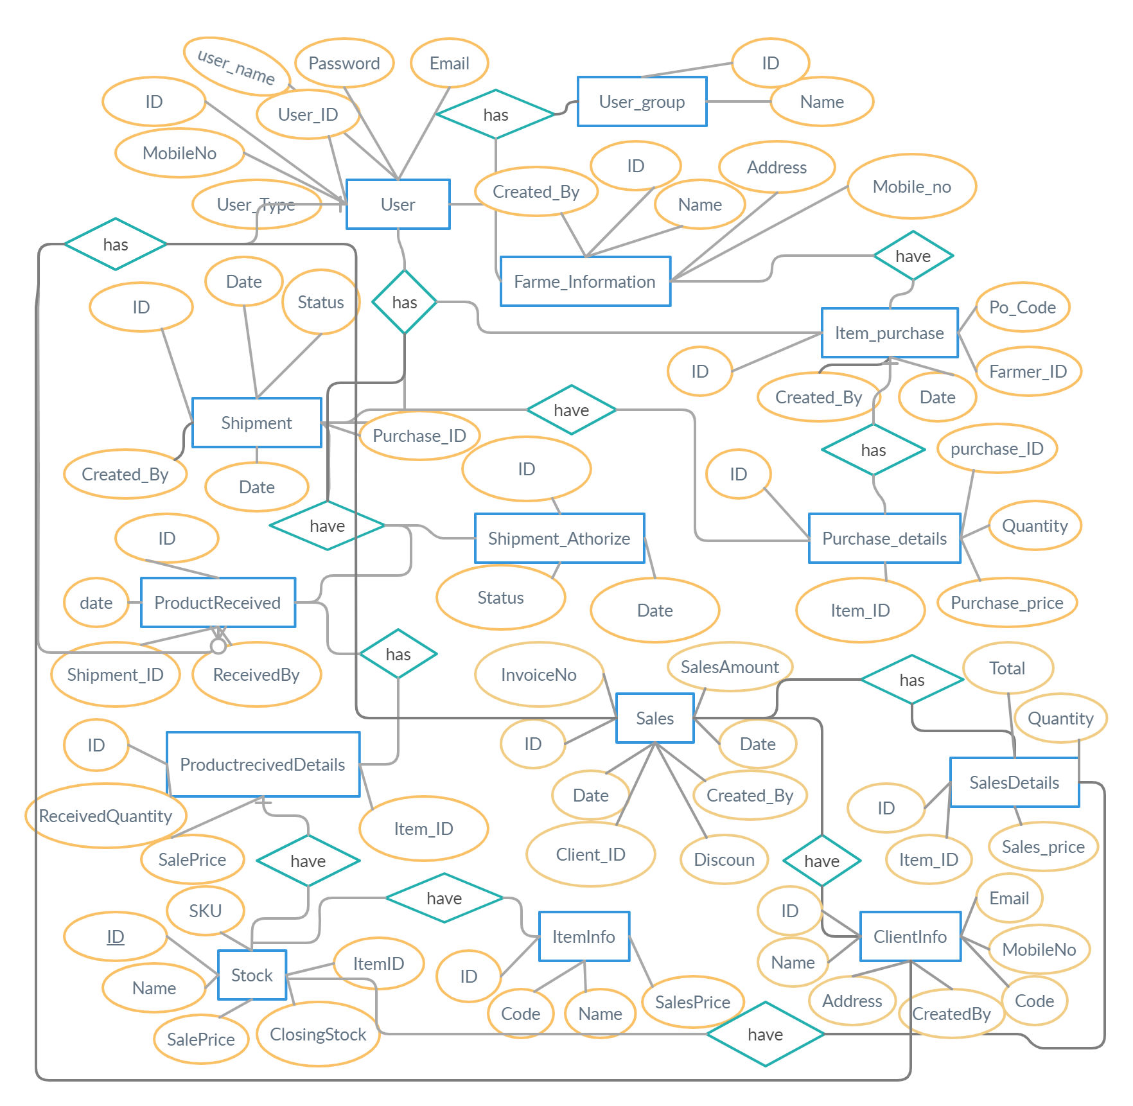
DATABASE E-R DIAGRAM:
Supply Chain Management System

Slide 9
REQUIREMENT STUDY:
From Online Media
Communicate with some small supply agent and farmer through over phone.
Supply Chain Management System

Slide 10
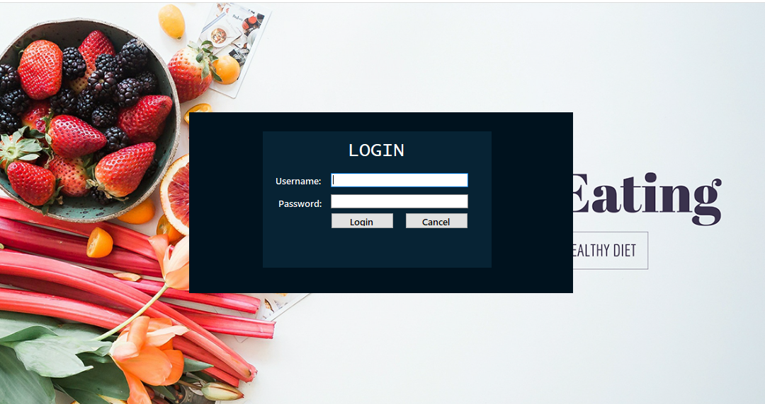
This is the first interface of Supply Chain Management System. Administrator, Agent,
Operator & Others users use his own user name & Password to login. First of all only
Administrator can login in Application, then setup other users login Permissions.
Supply Chain Management System

Slide 11
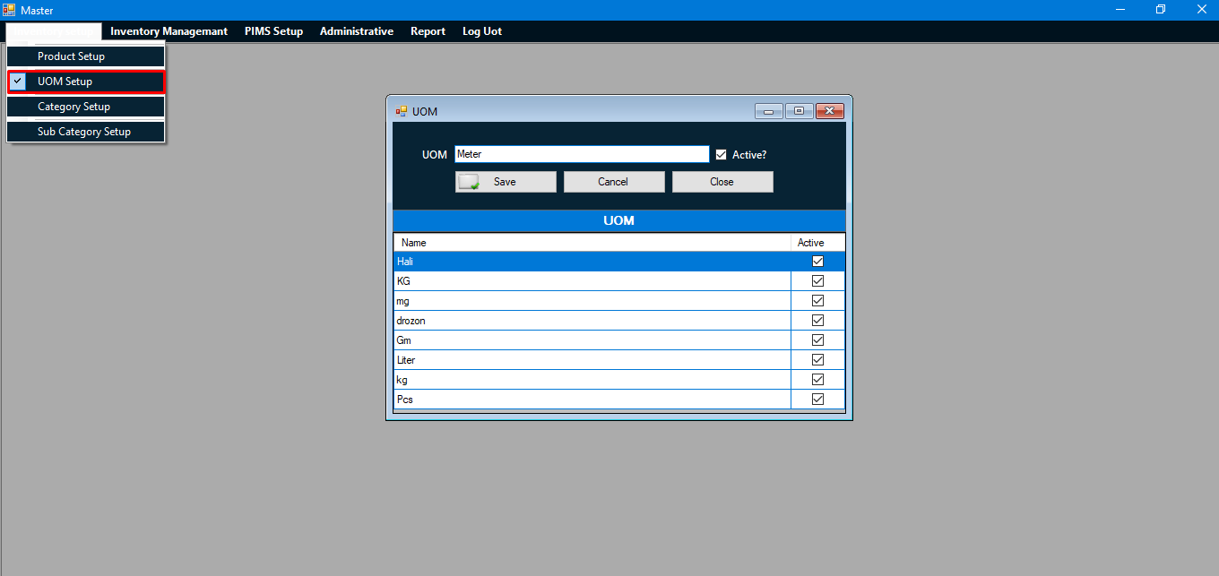
UOM is used to add the units that are used according to the product.
Supply Chain Management System

Slide 12
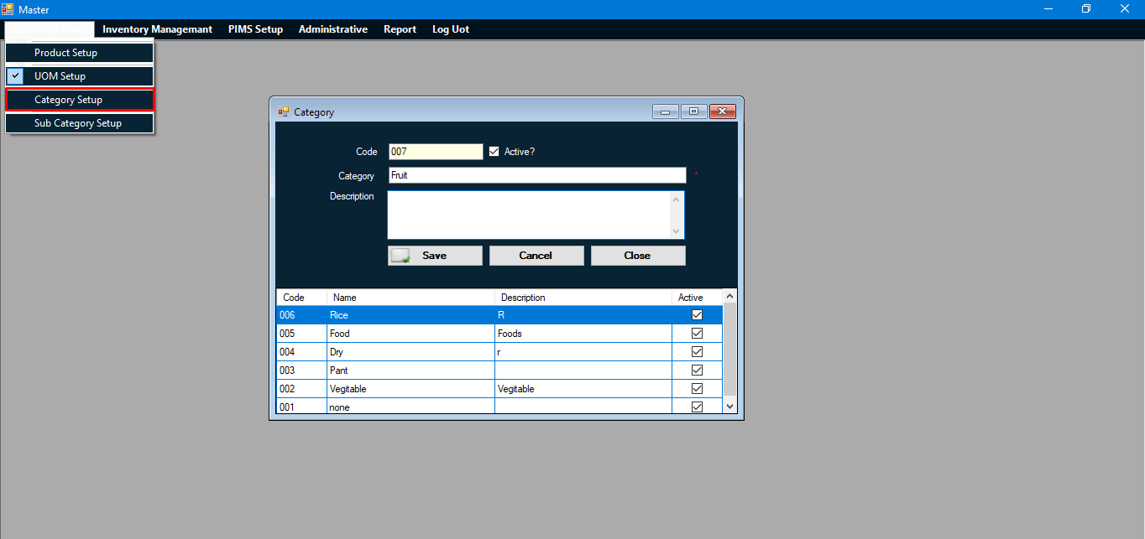
This menu has been used to create product categories. Such as: fruit, rice,
fish, meat can be.
Supply Chain Management System

Slide 13
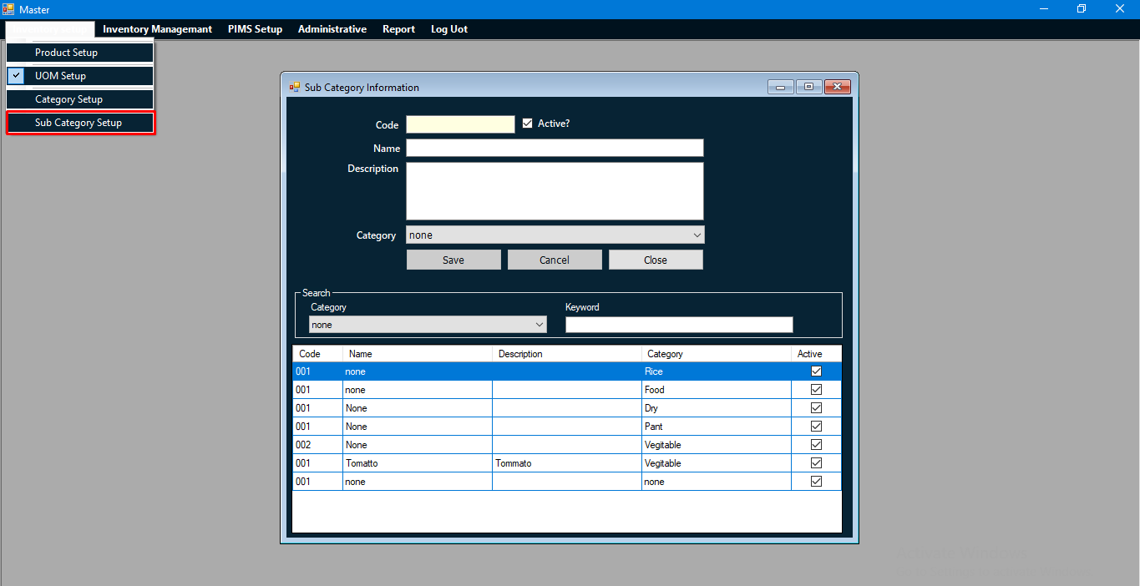
This menu has been used to create product Sub categories.
Such as: Marine fish, haor fish, saltwater fish can be.
Supply Chain Management System

Slide 14
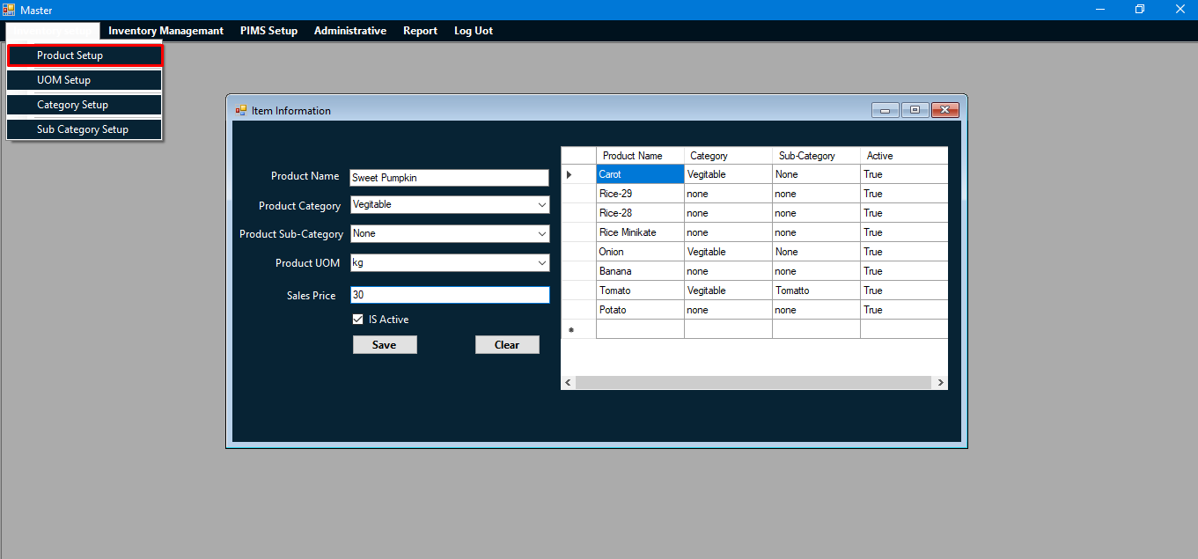
First have to set up the product which will be purchased from the farmer or agent.
Add the product name, unit, category, price in order to purchase any product in the
right way.
Supply Chain Management System

Slide 15
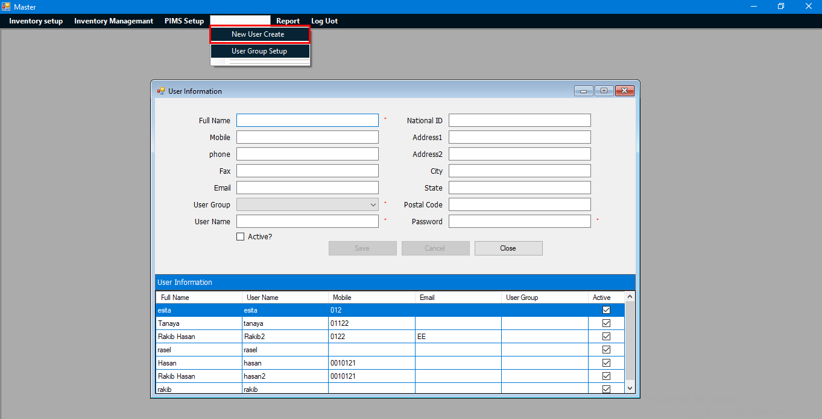
Only the administrator can operate the application first. But the operator,
the agent has to give permission from the panel created by the new user to
run the application.
Supply Chain Management System

Slide 16
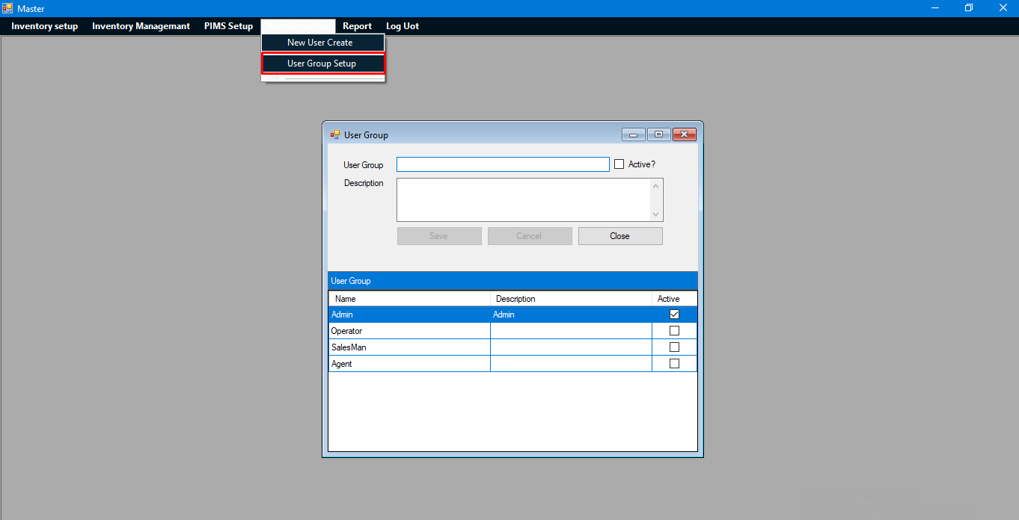
This panel is used to set the role when adding a new member.
For example, is he an operator, agent, farmer or dealer.
Supply Chain Management System

Slide 17
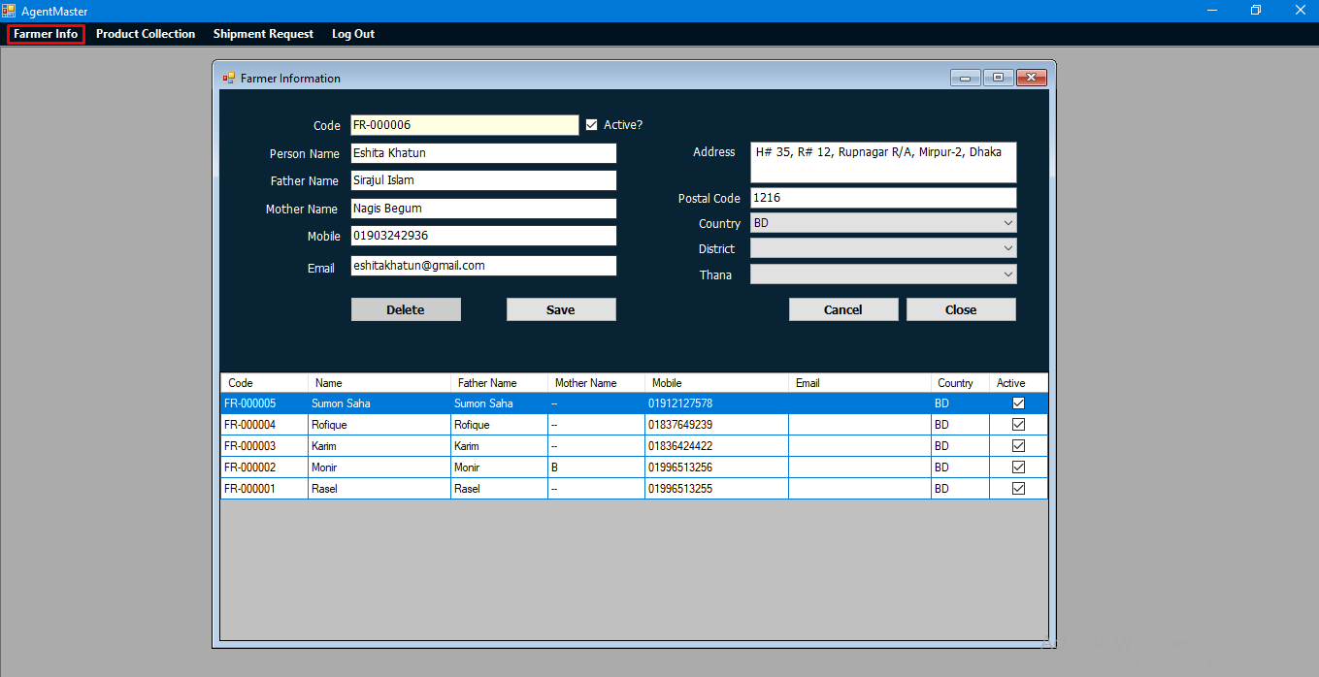
When an agent's roll is created, the agent will first complete the farmer's
Profile with the farmer's detailed information (Name, Father name, mother
name, phone number, email address, location etc.).
Supply Chain Management System

Slide 18
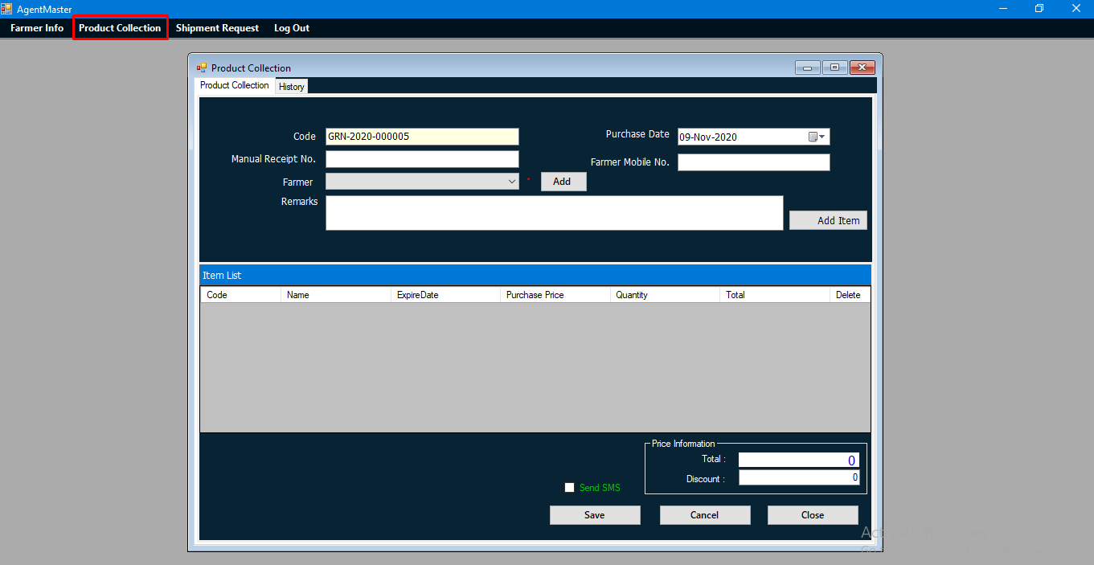
This panel is used to collect products from farmers. From here, farmer name, product description and product price is insert and saved. As well as informing the farmer through SMS.
Supply Chain Management System

Slide 19
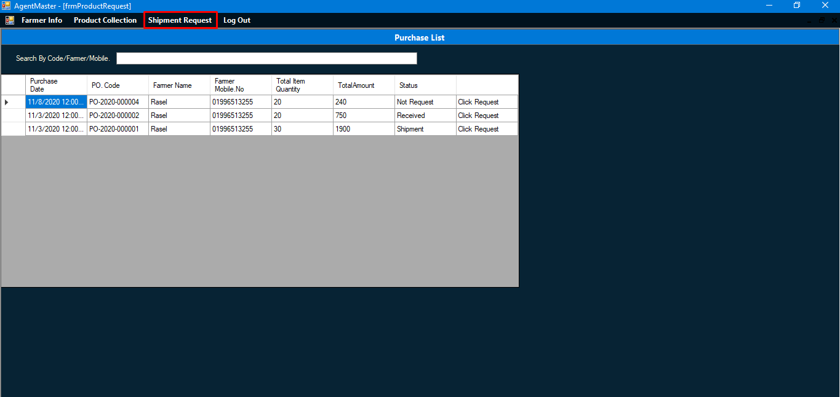
The agent sends a request to the administrator for permission to Shipment product
from the farmer through this panel.
Supply Chain Management System

Slide 20
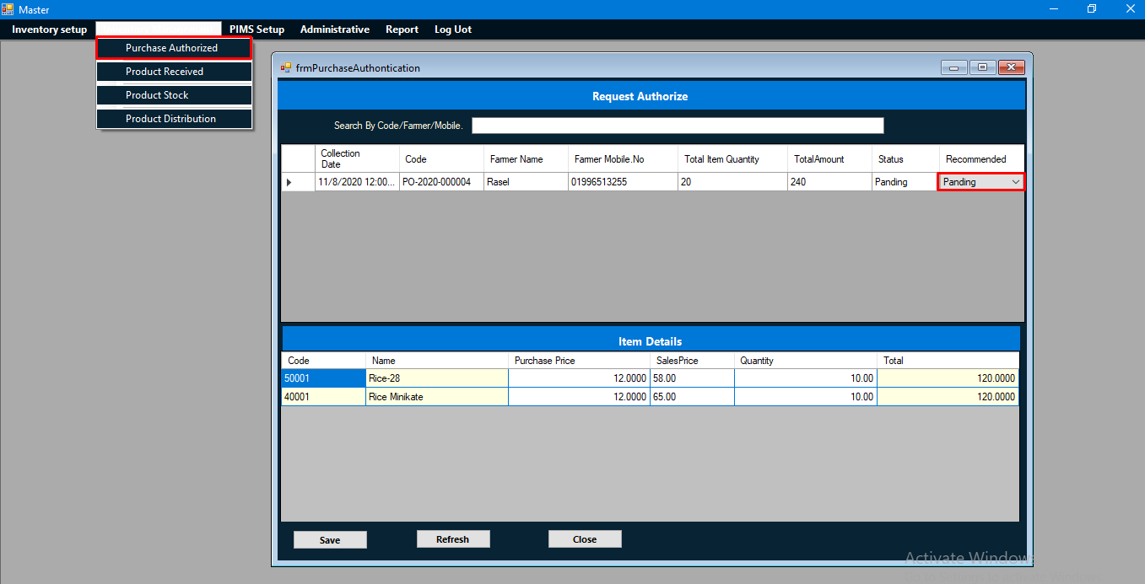
After a shipment request from the agent, a notification for permission
comes to the administrator. The agent can shipment only if the administrator
accepts the request.
Supply Chain Management System

Slide 21
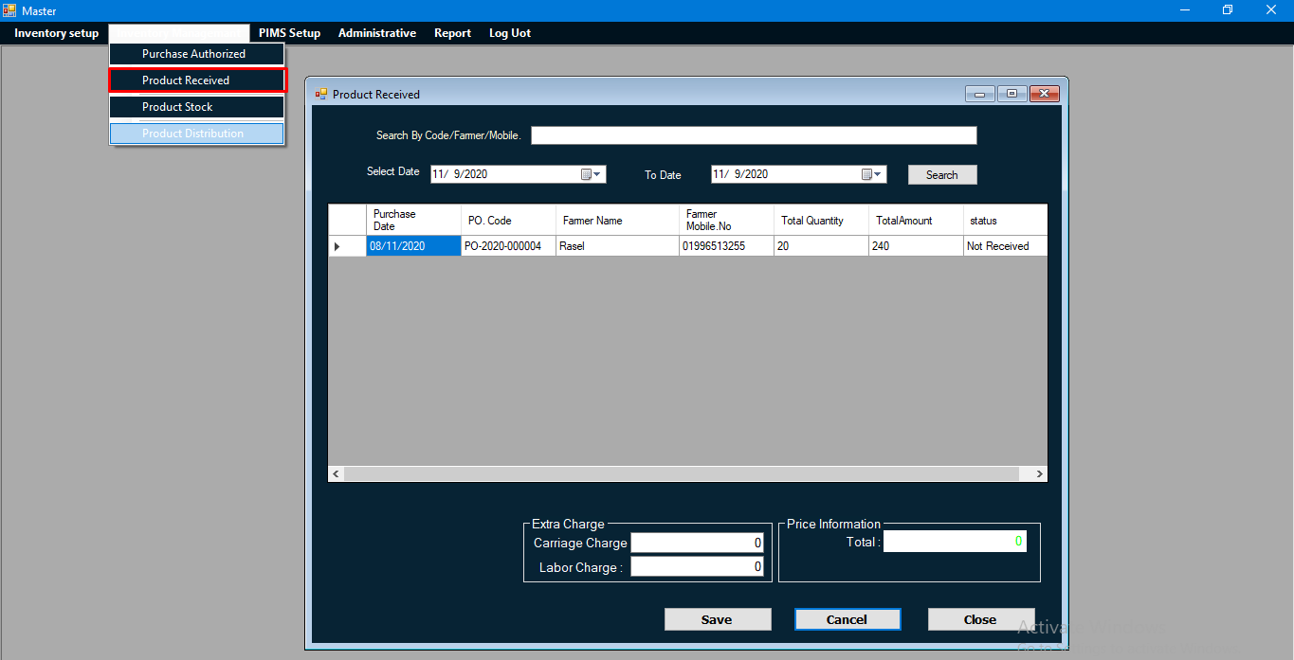
. After Shipment Authorize the product, then Product are available for Received , then products will be
stored in the Stock.
Supply Chain Management System

Slide 22
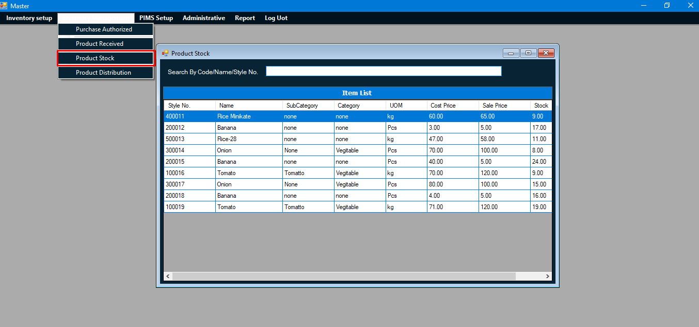
The product stock panel is used to check the stock after shipmet and
Receiving the product. Detailed information of the product in stock is
available from here.
Supply Chain Management System

Slide 23
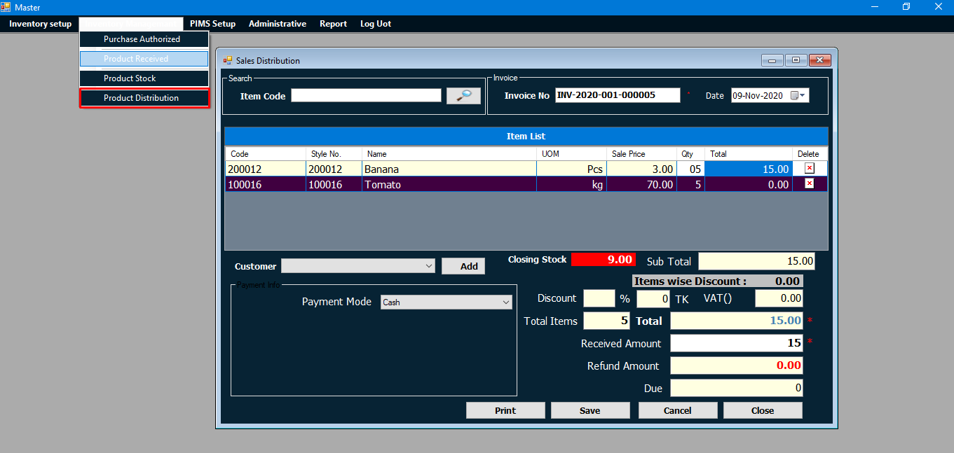
Product distribution is the sale of goods directly to a Client. From this
panel the product is sold by calculating the price and discount with the detailed
data of the product.
Supply Chain Management System

Slide 24
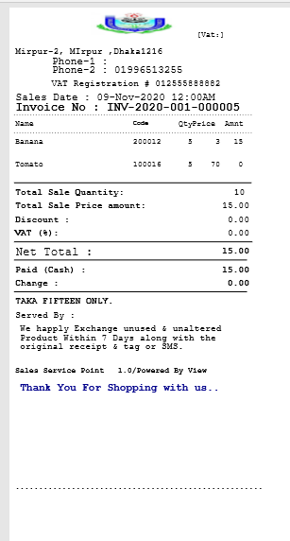
This report to print after the product is sold and collect
sales information.
Supply Chain Management System

Slide 25
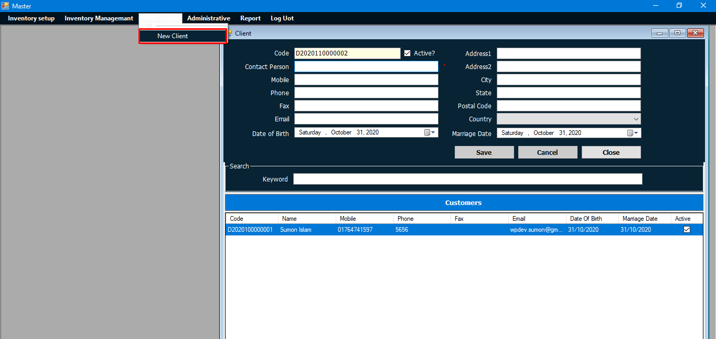
This panel is used to save the seller's information in advance to sell the product
to a new seller.
Supply Chain Management System

Slide 26
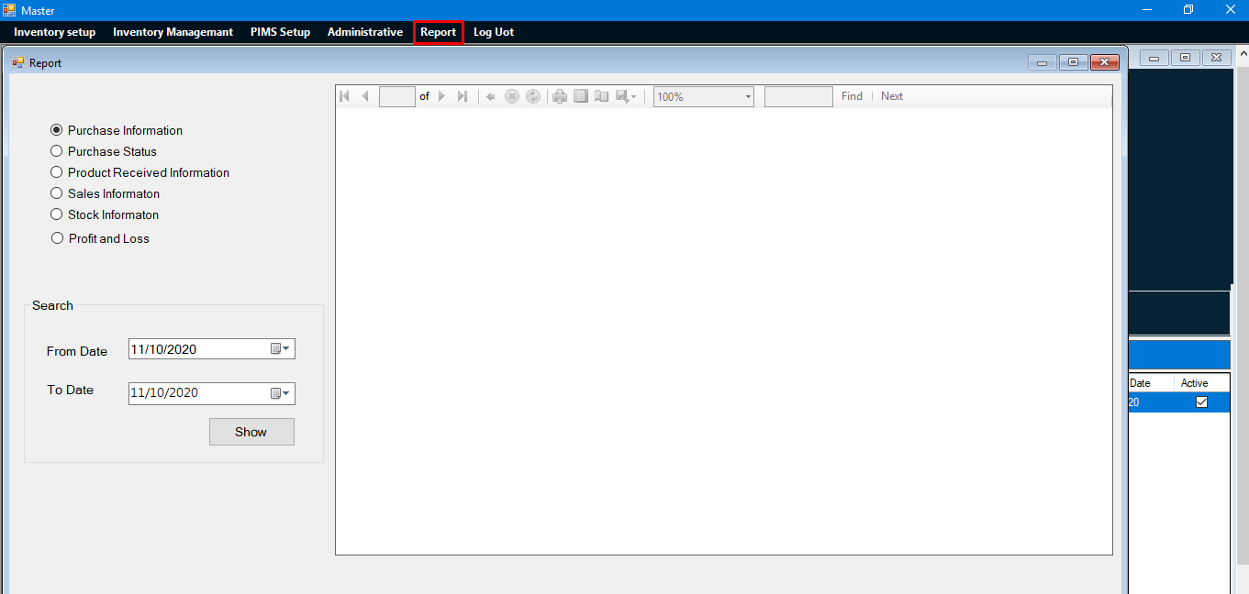
Sales information, purchase status, stock information, profit and loss reports
are available from the report panel.
Supply Chain Management System

Slide 27
CONCLUSION:
Farmers, Dealers, Retailers and buyers will benefit financially by using This System and get hygienic and good quality product.
Supply Chain Management System

